Slide 1
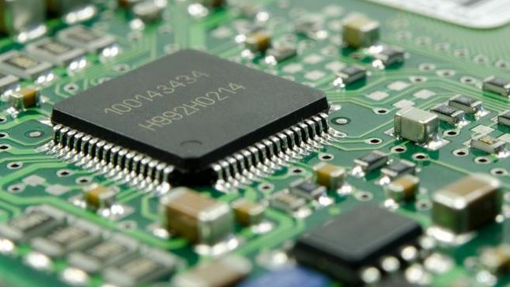
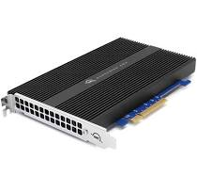
Chapter 4: Cache memory

Slide 2
Characteristics of
Memory Systems

Slide 3
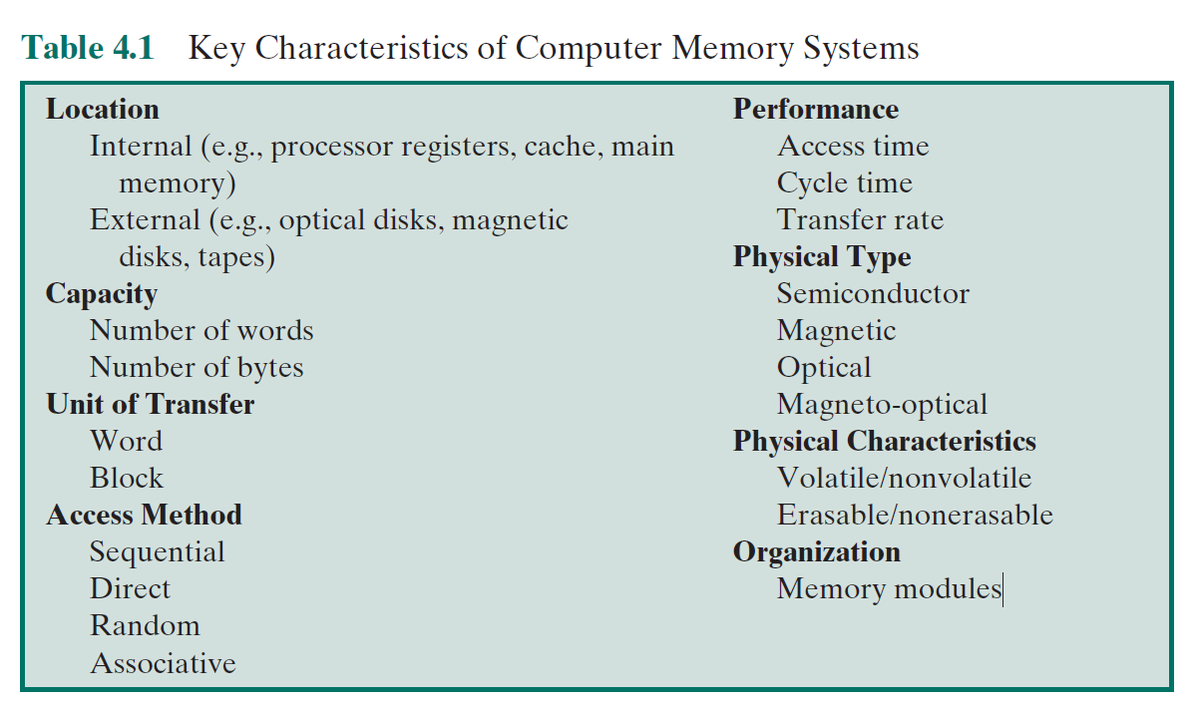
Key Characteristics of Computer Memory Systems

Slide 4
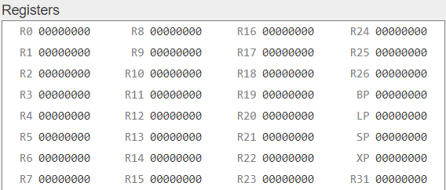
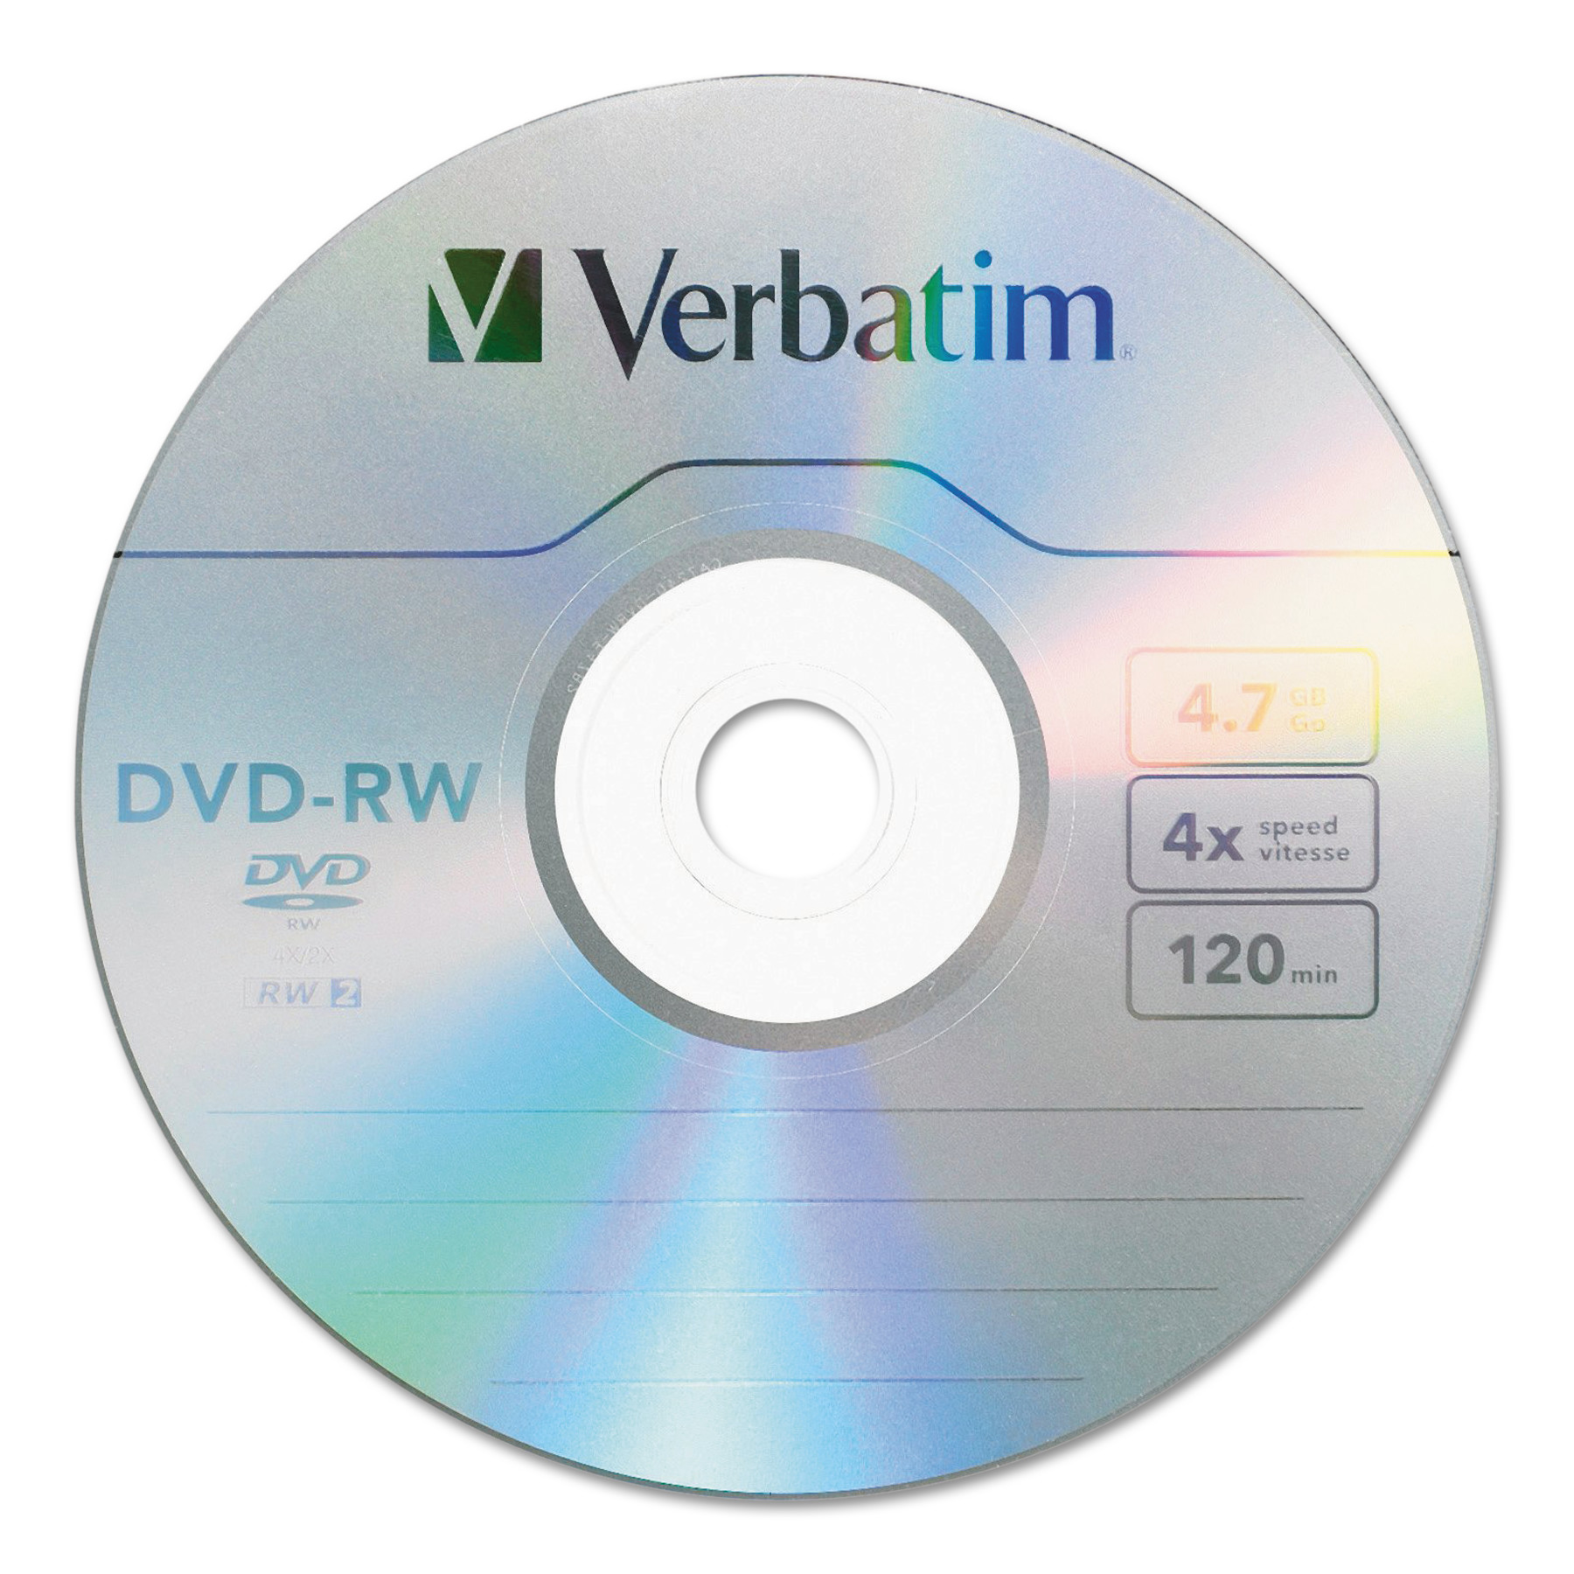

Location
Internal memory
  Often known as main memory
  Processor requires its own local memory in the form registers
  Further, the control unit of the processor may also require its own internal memory
  Cache is another form of internal memory
External memory
  Peripheral storage devices such as disk, tape
  Accessible to the processor via I/O controllers

Slide 5
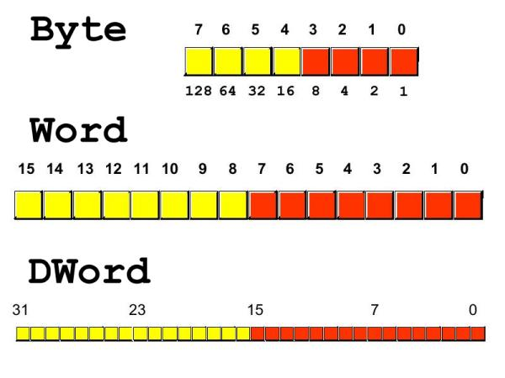
Capacity
 | Byte | Word
Length | 8 bits | Common lengths are 8, 16, 32 bits
Uses in | Internal memory External memory | Internal memory

Slide 6
Unit of transfer:
For internal memory, the unit of transfer is equal to the number of electrical lines into and out of the memory module
This may be equal to the word length, but is often larger, such as 64, 128, or 256 bit
Concepts:
  Word
    “natural” unit of organization of memory
    Size typically equals to number bits represent an integer or instruction length
    Exceptions: CRAY C90: 64-bit word / 46-bit integer, Intel x86: 32-bit word / variety instruction lengths
  Addressable units
    Some system, Addressable units equal to word or byte
    But in any case, Addressable units always equal to 2^{length in bits}
  Unit of transfers
    Main memory : number bits read out/ written into at a time
    External memory Much larger units than a word, referred to as blocks

